Slide 1
Learning Progressions
Water in Socio-ecological Systems
Kristin Gunckel, University of Arizona
Beth Covitt, University of Montana
Charles (Andy) Anderson, Michigan State University
Math Science Partnership (MSP) Culturally Relevant Ecology, Learning Progressions and Environmental Literacy
Reasoning Tools for Understanding Water Systems (DRK12)

Slide 2
Overview
Introduction to Learning Progressions
Explore some data for patterns
Develop learning progressions
Compare to the Learning Progression for Water in Socio-Ecological Systems
Notes:
Today we’re going to give a brief overview of environmental science literacy and learning progressions for water in socio-ecological systems.

Slide 3
Learning Progressions
Descriptions of the successively more sophisticated ways of thinking about a topic that can follow one another as children learn about and investigate a topic over a broad span of time. (NRC, 2007)

Slide 4
Helps Us Think About
How students’ ideas change from their initial ideas to more scientific thinking.
What the connections are between students’ experiences and how they are thinking about concepts at different points in their K-12 schooling
How this knowledge can help us rethink curriculum to best help students learn.
Notes:
To support students in becoming environmentally literate citizens, we need to know how students ideas and the connections they see in their experiences change as they move through school.

Slide 5
Learning Progressions
Upper Anchor = Scientific Reasoning
What high school students should know and be able to do
Lower Anchor = Informal Ideas
How children think and
make sense of the world
Notes:
Learning progressions connect how students think about the world to the scientific ideas we would like them to know and be able to use when they finish high school. Learning progressions are different from scope and sequences because they start with the empirical evidence about how students see the world and trace their learning from there.
First we need to define the upper & lower anchors.
Upper anchor – what we want HS students to know and be able to do
Based on:
Cutting-edge science (too complex to be used as is)
Societal needs
What’s achievable (from educational research)
Lower anchor – how children think and make sense of the world
Based on:
Empirical research on current student understanding
Based on educational research guided by upper anchor (e.g., research reported in this talk)
Then we need to figure out reasonable steps between the upper and lower anchors that are responsive to children’s ways of thinking and reflect gradually more sophisticated ways of thinking.

Slide 6
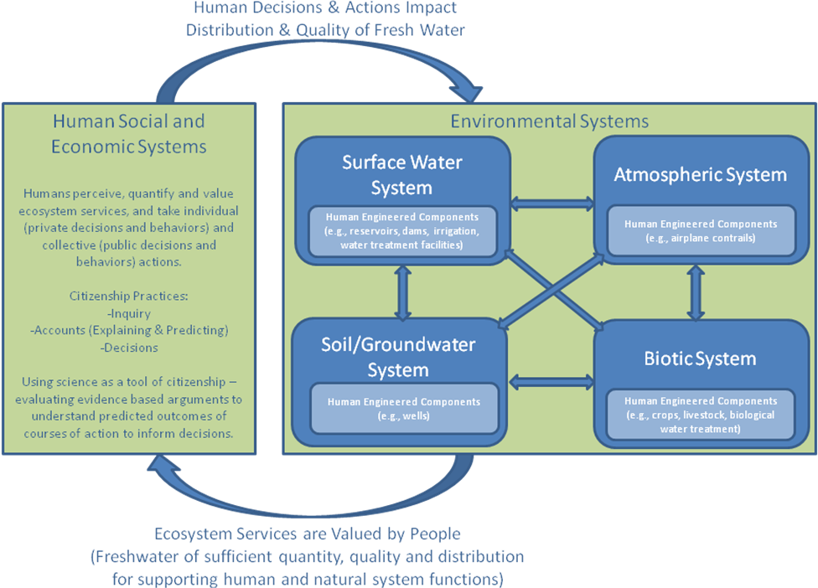
The Loop Diagram
Notes:
Here is how we think about what environmentally literate citizens need to know about water.
There are two boxes here. The right box represents all the systems through which water moves, including human systems. The arrows within the right box represent the processes that move water, such as evaporation or infiltration or precipitation. Environmental systems an important service valued and necessary for life, in this case abundant supplies of high quality fresh water. Human actions and decisions have impacts back on the water moving through environmental systems.
We argue that environmentally literate citizens should have an understanding of the structure of systems that water moves through, the processes that move water and substances through these systems, and the principles that govern the movement of water and substances. Furthermore, citizens can reason about water moving through these systems at all scales from landscapes to atomic-molecular.

Slide 7
Two Foci
Water moving through connected systems
Natural (atmospheric, surface, soil/groundwater, biotic)
Human-engineered
Substances in water moving through connected systems
Mixing
Moving
Unmixing

Slide 8
Developing a Learning Progression
ASSESSMENTS:
Develop/revise interview protocol and written assessment items; Collect data
INTERPRETATION: Analyze data and identify patterns of students’ learning performances
MODEL OF COGNITION: Develop/Revise Learning progression framework

Slide 9
Exploring Student Data
For each item (Soccer Field, River Maps, Fertilizer)
Rank the items from least sophisticated (1 ) to most sophisticated (10).
Group the ranked items into 3-5 groups based on common characteristics.
Describe the characteristics of each group for each item

Slide 10
Synthesize Levels
Look across the groupings for each item.
Synthesize into a master learning progression (lowest level on the bottom) by describing common features across the groupings for all three items. This is your draft learning progression.
Compare your learning progression with another group.
What is similar?
What is different?

Slide 11
Upper Anchor: Scientific Model-Based Reasoning
General
Phenomena are parts of connected, dynamic systems that operate at multiple scales according to scientific principles
Models are abstractions of systems that focus on key features to explain and predict scientific phenomena
Processes operate at multiple scales (landscape, macroscopic, microscopic, atomic-molecular
Water
Water and substances move through connected systems
Driving forces: Gravity, pressure
Constraining Factors: permeability, topography, solubility, conservation of matter, etc.
Processes operate at multiple scales

Slide 12
Lower Anchor: Force Dynamic Reasoning
Actors with purposes/needs confront antagonists (hindering forces)
Events determined through interplay of countervailing powers
Humans have most powers/abilities; non-living entities can be actors too
Example: Tree’s purpose is to grow. Enablers include sunlight, soil, and water. Antagonists include drought and logging.

Slide 13
Levels of Achievement
Levels of Achievement | Progress Variables
 | Moving Water | Substances in Water
4: Qualitative model-based accounts | Traces water through connected systems (multiple pathways/scales). Identifies driving forces and constraining variables | Identifies and traces substances mixing, moving, and unmixing with water (multiple pathways/scales). Identifies chemical nature of substances in water
3: “School science” accounts | Puts events in order Does not use driving forces or constraining variables Descriptions at macroscopic scale | Identifies types of substances with moderate specificity Distinguishes types of mixtures based on macroscopic properties and interactions
2: Force-dynamic narratives with hidden mechanisms | Recognizes water can move and that there are hidden mechanisms moving water. Uses force-dynamic thinking that invokes actors or enablers. | Recognizes water quality can change. Thinks of water quality in terms of bad stuff mixed with water. Invokes actors or enablers to change water quality.
1: Force-dynamic accounts | Focuses on human-centric actions & concerns Focuses on immediate and visible Does not view water in a location as connected to other water. | Views water quality in terms of types of water (e.g. dirty water). Actors can change water without mechanisms (e.g., using a cleaning machine)
Notes:
Progress along the levels of achievement represents not only addition of concepts, but also a change in how one thinks about the world.
The lower anchor represents force dynamic thinking – Where actors and enablers do things to water to change it or make it move.
The upper anchor represents model-based reasoning. – What we expect students to achieve by high school. Uses principles to reason about where water goes or what is in water.
An important level of achievement in this research is Level 3 – School science narratives. Can tell stories about where water goes, but does not use principles such as gravity or permeability to reason about pathways or what is in the water.

Slide 14
Recent Results*
*2007-2008 data, Gunckel, Covitt, Salinas, & Anderson (in review).

Slide 15
Patterns
By high school, most students do not reach Level 3 and few students reach Level 4.
Students may score at different levels on different systems.
At highest levels on systems with which have most experiential and curricular familiarity.
Most challenges are related to understanding
Invisible and hidden processes & connections
Using representations to reason at multiple scales
Using driving forces and constraining factors to reason about pathways

Slide 16
Next Steps
Formative assessments
Tools for reasoning

Slide 17
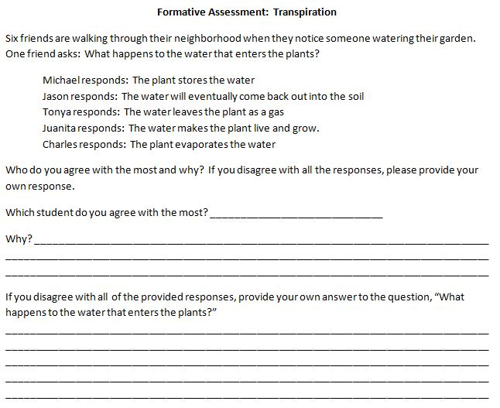

Slide 18
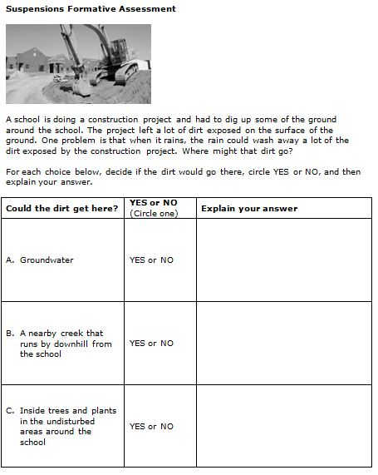

Slide 19
Connecting Student Responses to the Learning Progression Framework
 | Level 1 | Level 2 | Level 3 | Level 4
A. Groundwater | No – No – The dirt cannot get underground. Yes – Dirty water is underground. | Yes - The dirt will go into the groundwater because the water goes into the groundwater. Yes – The dirt could fall into the groundwater. Yes – The ground absorbs the dirt. Yes – The dirt dissolves into the ground. No – The ground cleans the water. | No – Dirt will not go with the water into the ground. | No –The pores in the soil/ground are too small for the dirt to move through and the dirt will be filtered out.
B. A nearby creek that runs by downhill from the school | No - Yes – The creek is dirty No – The dirt doesn’t move. | Yes – If the water from the school is connected to the creek. Yes - The wind blows the dirt into the creek. No – The creek is not connected to the dirt at the school. No - The dirt is not near the creek. | Yes – The dirt goes with the water to the creek. | Yes – The tiny dirt particles are in suspension and will be carried with the water as it runsoff down to the stream because of gravity.
C. Inside trees and plants in the undisturbed areas around the school | No – No – The dirt doesn’t move. No – Plants don’t drink dirt. | No – The dirt cannot go into the plants. Yes – If the plants drink the dirty water. | No – Dirt does not move with water into trees and plants. | No – The openings in the plant roots are too small for the dirt particles to move through and the dirt will be filtered out.

Slide 20
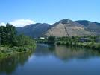
Pathways Tool
Before
In the groundwater along the flood plain along the Clark Fork (upstream of Hellgate) (some)
Snow on the mountain peaks (a little)
In the atmosphere as water vapor (a little)
As clouds (a little)
Other rivers or lakes (a little)
Oceans (a little)
After
In the groundwater
In the atmosphere
In the X river
In Lake Pendeorelle
In pipes, water treatment plants, and sewers.
Before
Headwaters of the Blackfoot River (Some)
In the headwaters of the Clark Fork River (near Butte) (Some)
In the groundwater near the floodplain of the Clark Fork upstream of Hellgate (a little)
After
In the reservoir downstream
In the groundwater
In pipes
In water treatment plants
In the atmosphere
Before
Clark Fork river upstream , maybe near Milltown or Bonner (most)
After
In the river downstream near Frenchtown (most)
In the Missoula Aquifer going toward the Bitterroot (some)
Clark Fork River, Missoula, MT

