Slide 1
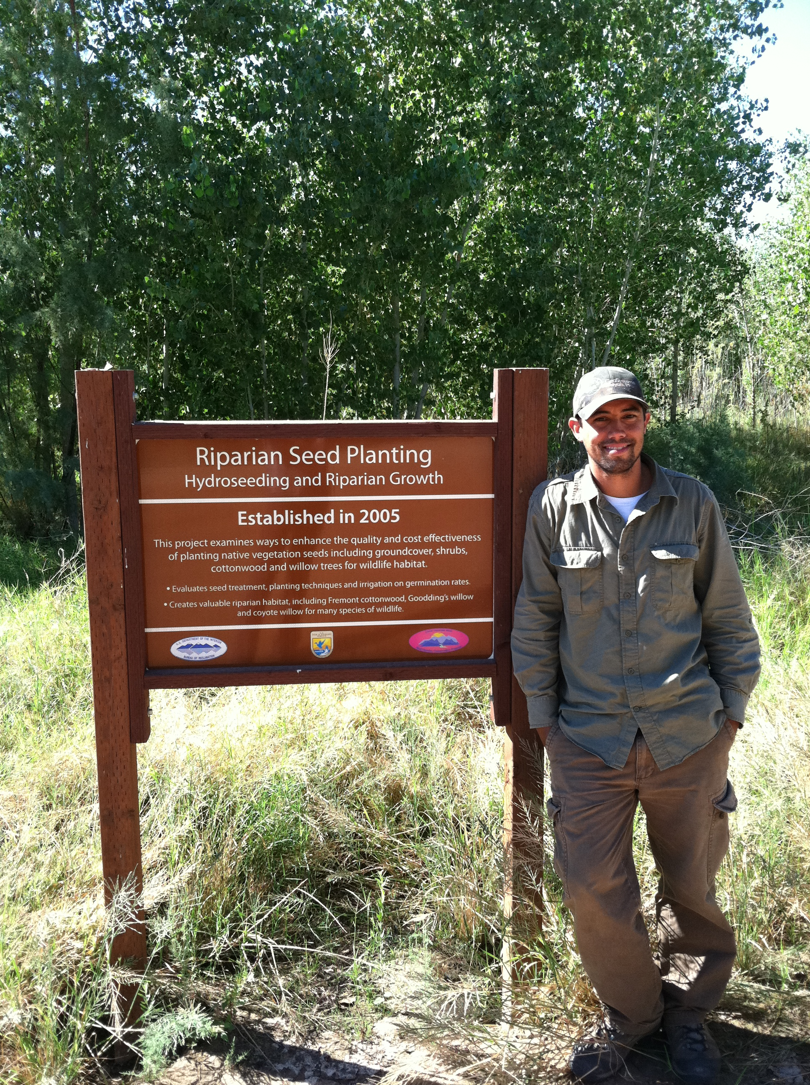
River Restoration in the 21st Century: Learning from the Colorado River
Advanced Water Education Workshop
Daniel Bunting –
(PhD) University of Arizona

Slide 2
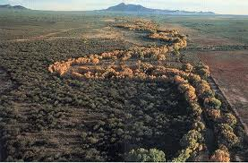
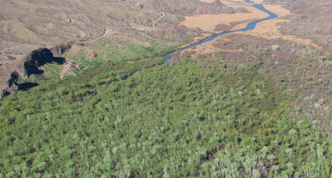
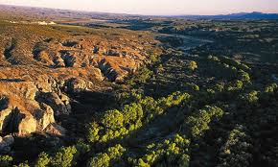
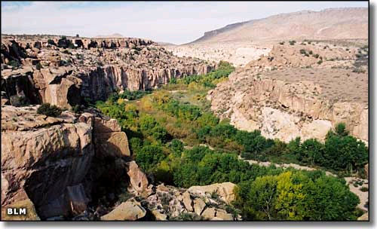
Desert Riparian Zones
  Water supply
  Pollution Control
  Hydropower
  Recreation
  Soil/Nutrient Cycling
  Climate Stability
  Maintains Biodiversity
  Benefits Wildlife

Slide 3
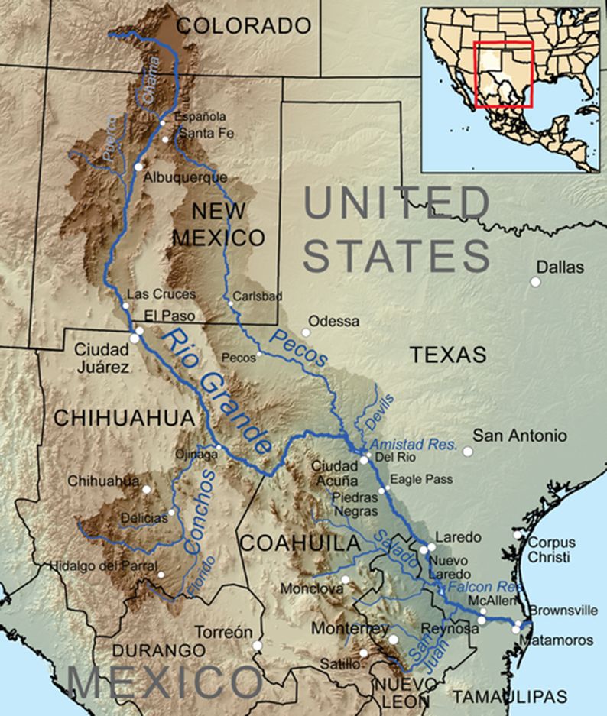
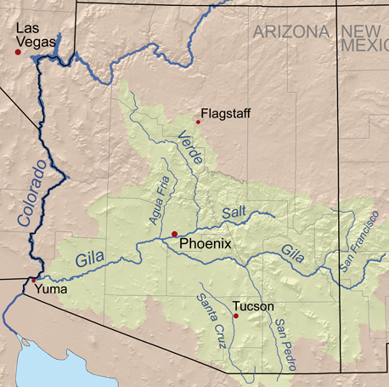
Southwest Rivers

Slide 4
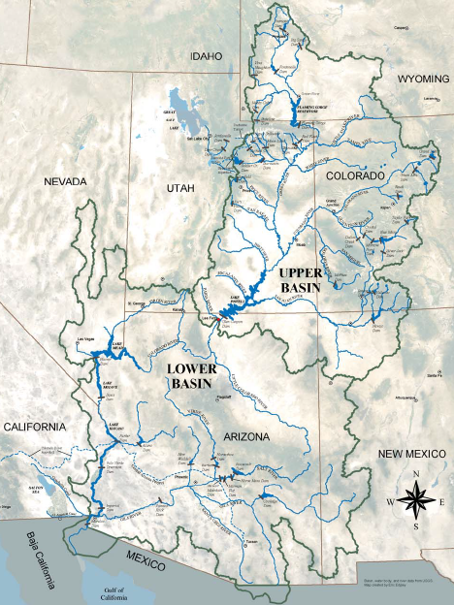
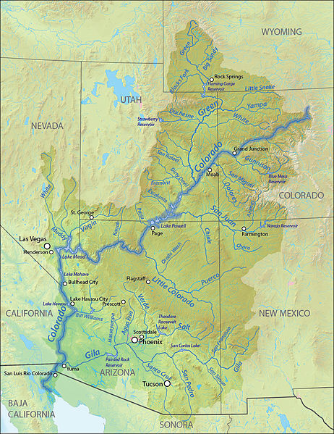
Colorado River Basins
Upper Basin States:
-Colorado
-Utah
-Wyoming
-New Mexico
Lower Basin States:
-California
-Arizona
-Nevada

Slide 5
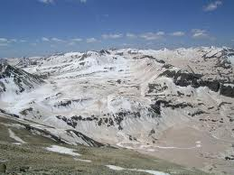
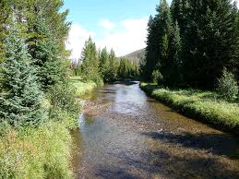
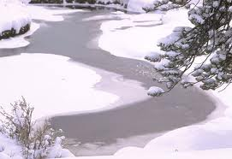
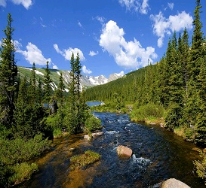
Colorado River
Headwaters
Rocky Mountain
National Park

Slide 6
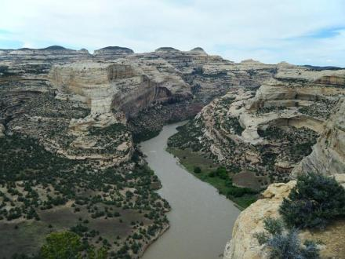
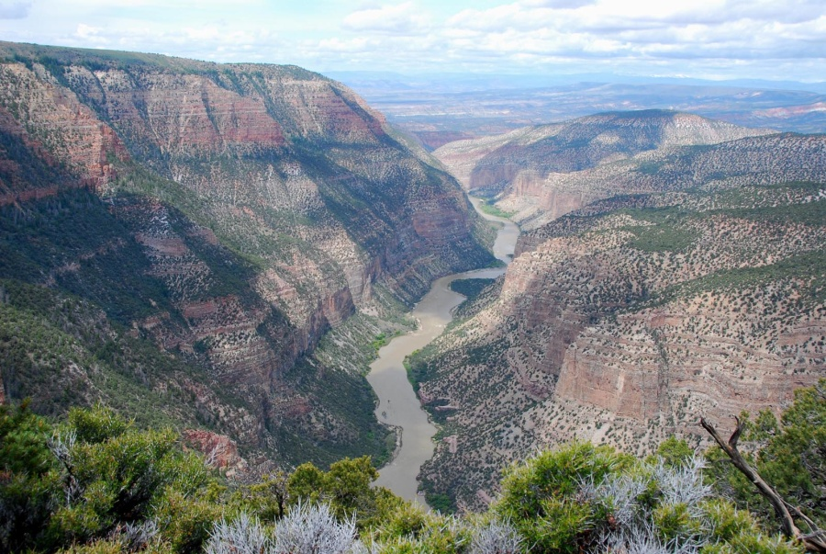
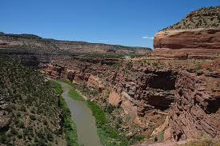
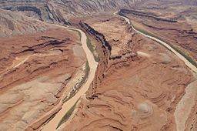
Upper Colorado River Tributaries
Yampa River
Green River
Dolores River
San Juan River

Slide 7
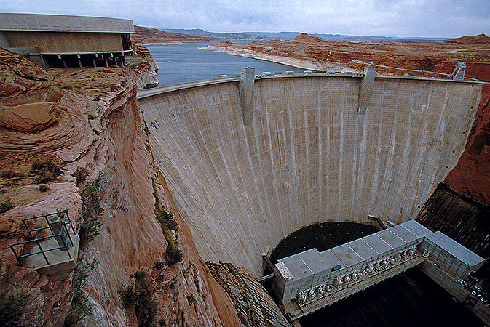
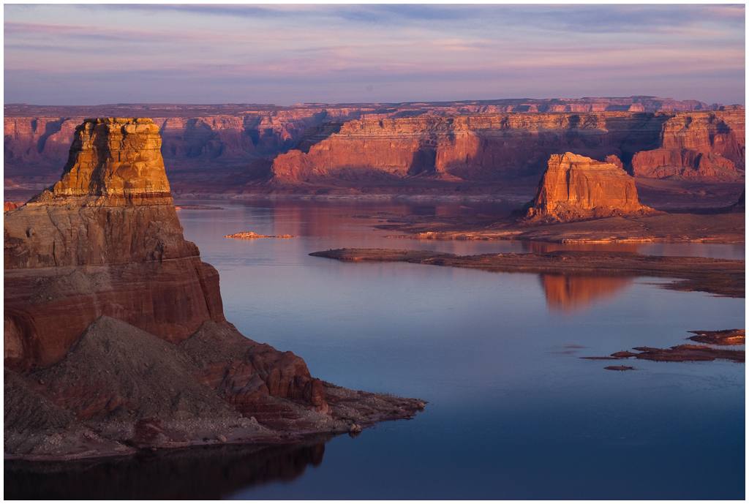
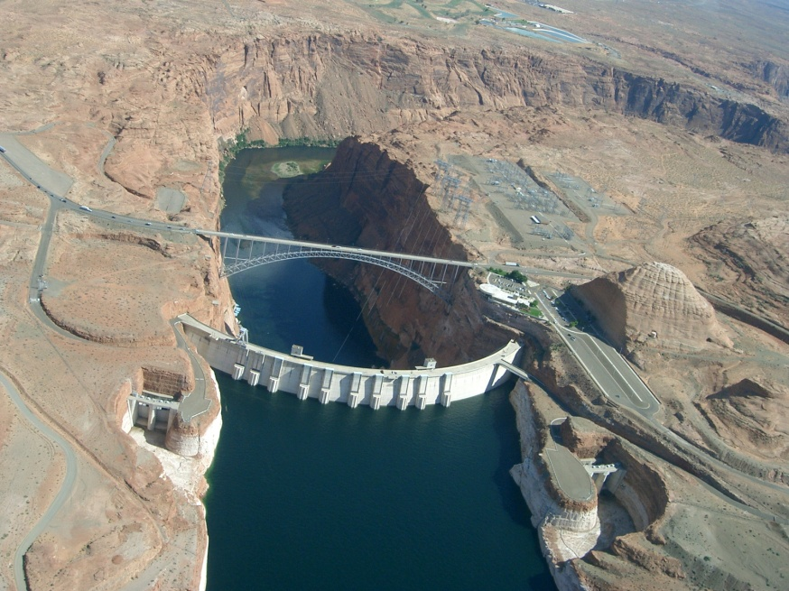
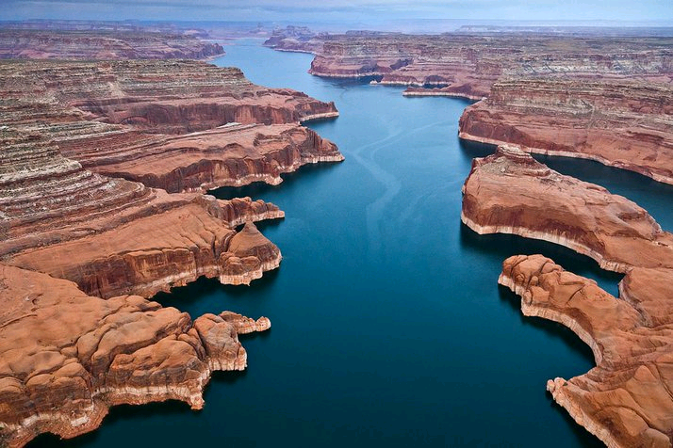
Glen Canyon Dam
Completed - 1966

Slide 8
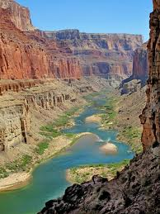
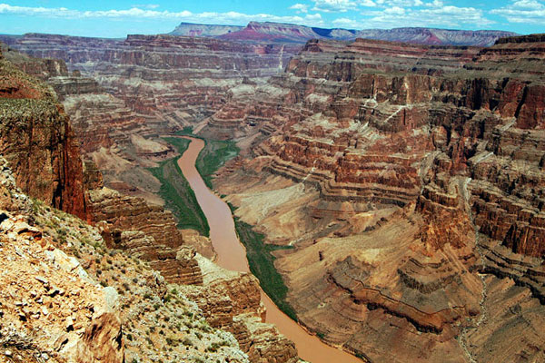
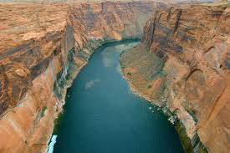
The Grand Canyon!!!

Slide 9
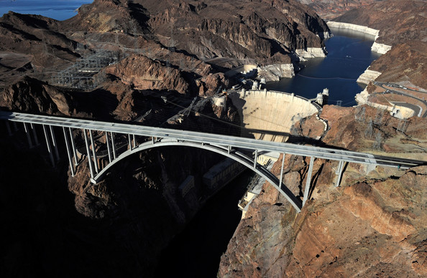
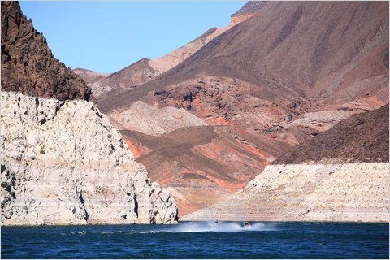
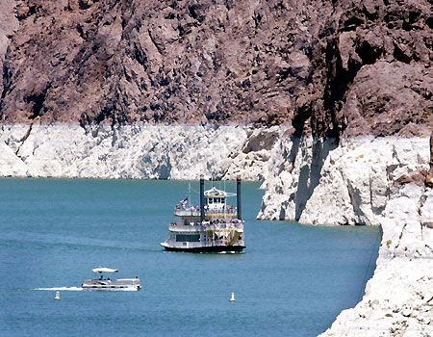
Completed - 1936

Slide 10
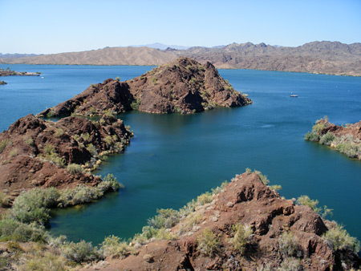
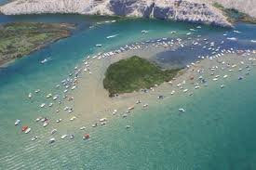
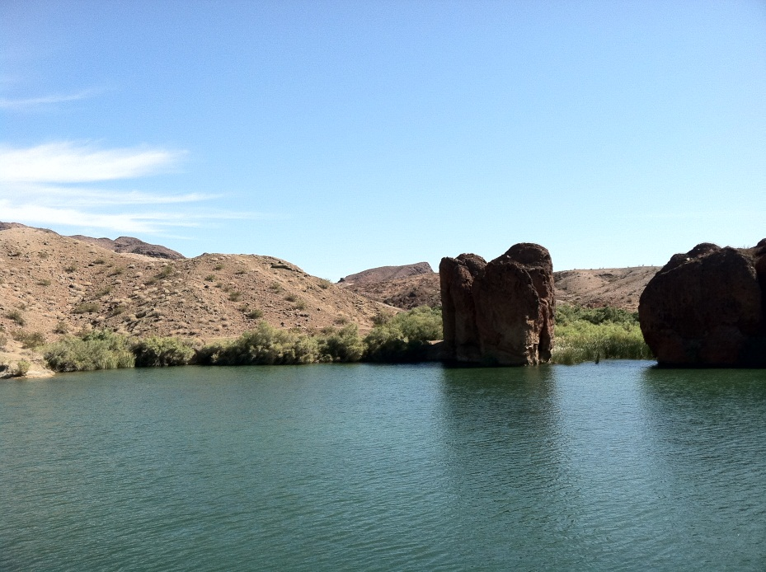
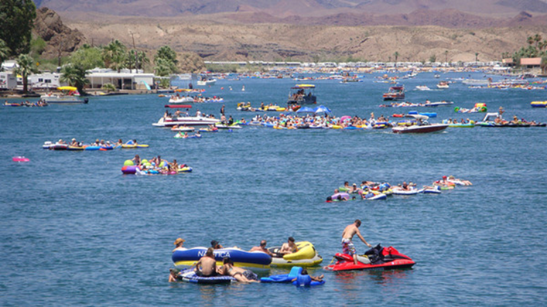
Lower Colorado River
– Lake Havasu, Parker

Slide 11
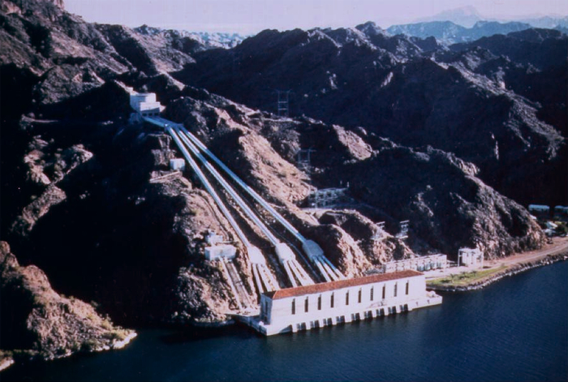
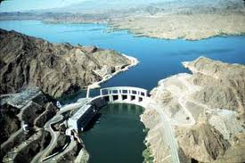
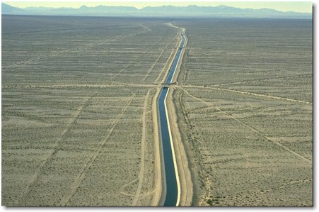
Colorado River Aqueduct
Construction completed: 1939

Slide 12
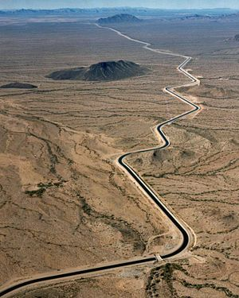
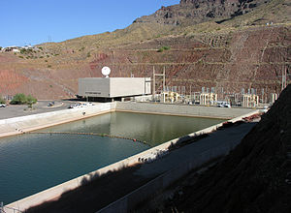
Central Arizona Project
(CAP)
Construction completed: 1990s

Slide 13
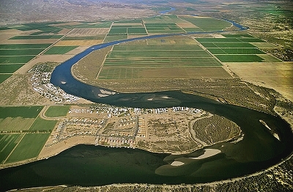
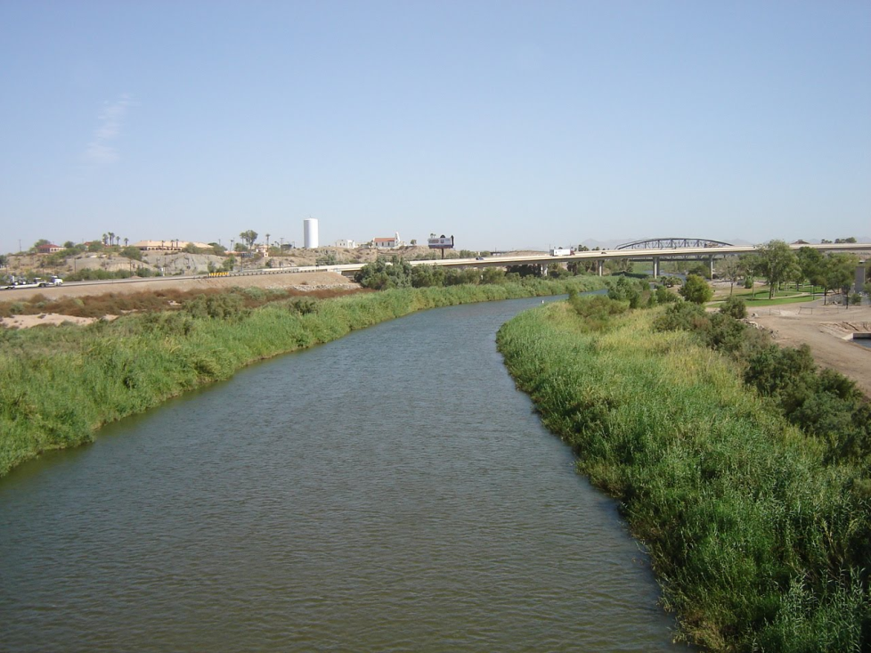
Lower Colorado River

Slide 14
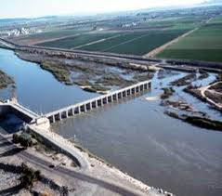
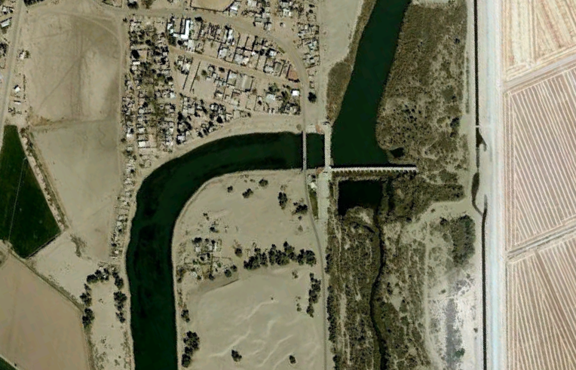
Morelos Dam, Mexico
Completed - 1950
Notes:
April 4, 2010, 7.2-magnitude Earthquake, 19mi south of Mexicali

Slide 15
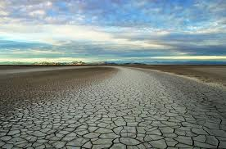
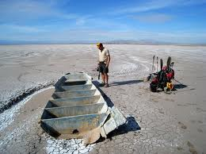
Colorado River in Mexico
Photo by Pete McBride
Photo by Pete McBride

Slide 16
How do we run a huge river dry?
Water is overallocated
7.5 maf Upper Basin States
7.5 maf Lower Basin States
1.5 maf Mexico
16.5 total
16.1 maf estimated from 1905-1922
12.4 maf estimated from 1895-2003
Minimum 3.8 maf (2002)
Maximum 22.2 maf (1984)

Slide 17
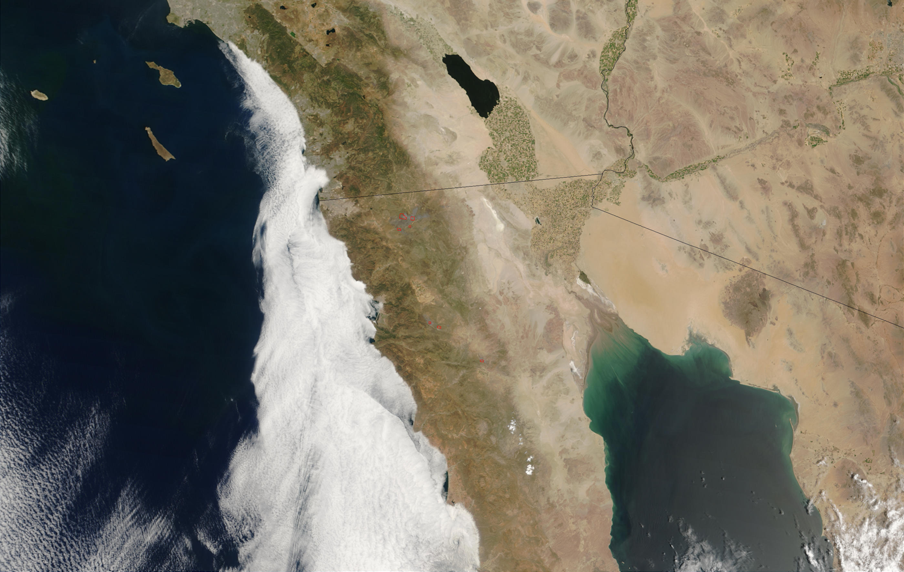
~70% of the Colorado River water is used for agriculture

Slide 18
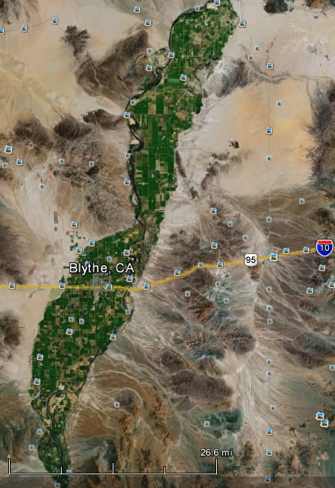
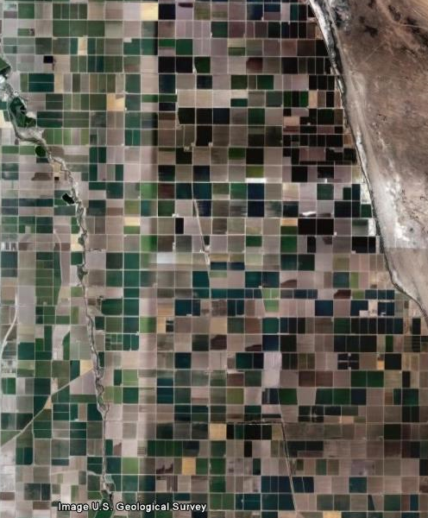
Agricultural Use on Floodplains

Slide 19
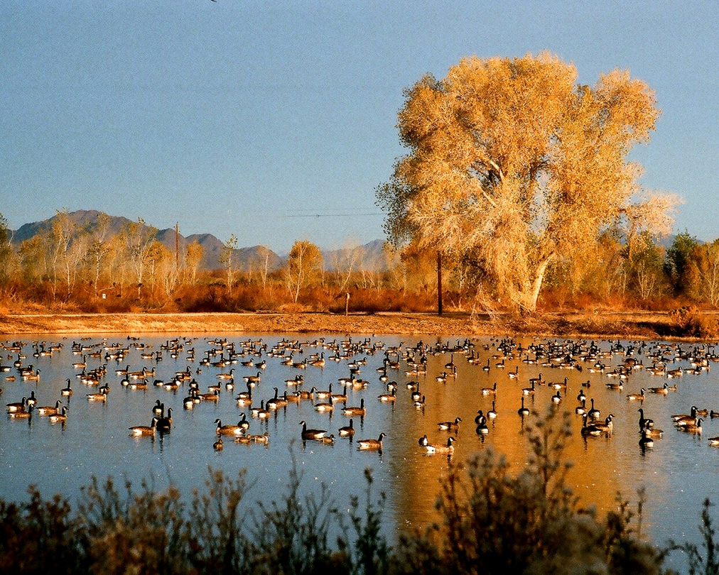
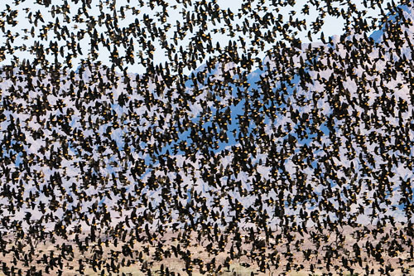
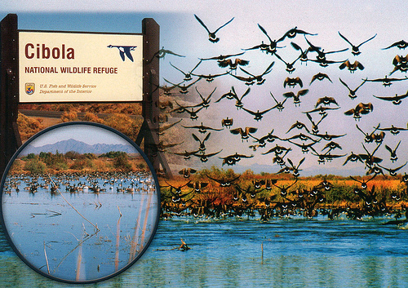
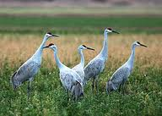
Photo by nhigh

Slide 20
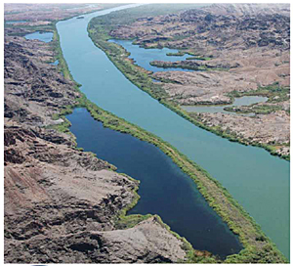


Lower Colorado River –
Multi-Species Conservation Program
50-yr, $626 million
Photo from BOR
26 federally listed endangered, threatened, or sensitive species
Habitat Creation: 5,940 acres of cottonwood-willow;1,320 acres of
honey mesquite; 512 acres of marsh; and 360 acres of backwater habitat

Slide 21
Restoration vs. Rehabilitation
TRUE RESTORATION
Can we bring back hydroecological processes?
Can we address the stressors responsible for river degradation?
REHABILITATION
Can we make improvements from current conditions?
Is it sustainable?
What is the ecological value?

Slide 22
Revegetation on Regulated Rivers
FEASIBILITY
Can we grow native riparian vegetation in the current conditions?
Are there water resources to sustain healthy trees?
TECHNIQUES
Pole cuttings/plantings
Containerized Stock
  Nursery plants in pots
Seeding
  Hydroseeding
  Broadcast seeding

Slide 23




Pole Plantings
Los Lunas / NRCS project
Los Lunas Plant Materials Center

Slide 24





Slide 25


Channelization and Levees

Slide 26



Nursery
Plant Stock & Vegetative Propagation

Slide 27





Transplanting

Slide 28





Aerial Views – Riparian Vegetation Restoration Plots

Slide 29






2007
2007
2008
2009
2010
2011

Slide 30


Slide 31





Native vs. Non-native Riparian Trees
Fremont cottonwood
(Populus fremontii)
Native species
Tamarisk/
Saltcedar
(Tamarix ramosissima)
Non-native species
Notes:
Same growing season

Slide 32


Methods (5 years of monitoring)
Permanent Quadrats
Density classes
Survival
Height
Diameter at Breast Height (DBH)
Point-intercept Transects
Overstory cover
Understory cover
Vegetation diversity

Slide 33

Overstory and Total Cover
Cottonwood dominated the overstory and total cover after 2 growing seasons, and continued throughout the study
All other vegetation cover generally decreased over time

Slide 34


Growth Rates
Cottonwood and tamarisk growth
was not impacted the same by density
  Cottonwood growth rates were often higher in lower density classes
  Tamarisk showed no trends in growth rate with density
Cottonwood has much higher growth rates than tamarisk
Although cottonwood growth rates have decreased over time, they may be stabilizing

Slide 35


Density Influences
Cottonwood and tamarisk are differentially influenced
While tamarisk was unaffected, cottonwood DBH and height decreased with increasing density

Slide 36

Plant Species Diversity & Richness
Diversity Index
Diversity initially decreases, but then increases slightly in the last two years
Richness
Overall, herbaceous species decrease throughout the study, while shrubs increase.
Species Richness

Slide 37

Density Effects on Plant Diversity
Snapshot after 4 years (2010)
Diversity doesn’t change once a certain # of trees establish

Slide 38


Slide 39





Slide 40

We need more research
Are these trees sustainable?
Do they provide suitable habitat for
bird communities?
What matters?
  Trees?
  Water and soil moisture?
  Invertebrates?
Long-term research
Nesting bird studies may take several years

Slide 41



La Cienega de Santa Clara:
An accidental example
Photo by: Francisco Zamora
Photo by: Ruben Ruiz

Slide 42
Colorado River Delta Restoration
Estimate of 100,000 AF of water per year to sustain native riparian vegetation
Or…4-500,000 AF every 4-5 years
This is less than 1% of the total flow
How important are environmental flows to the Delta?
How can Mexico secure in-stream flows?
Can Mexico store surplus water in US reservoirs for future use

Slide 43


Lake Mead Elevation

Slide 44

Thanks!
Questions/Discussion…

Slide 45
Colorado River Basin States & the
1922 Colorado River Compact

Slide 46

Colorado River Water Allocations
Upper Basin States
CA
CO
AZ
15.0 maf
Lower Basin States

Slide 47



7.5 maf
7.5 maf

Slide 48
What about Tribal water rights!?!
The U.S. failed to include Native-American rights to Colorado River water on reservations
  U.S. gave 0.9 maf to tribal lands (they use 80-90% for drinking water and agriculture)
    This water is taken away from the Lower Basin States
0.9 maf

Slide 49
What about Mexico!?!
The U.S. failed to include Mexico in the Colorado River water distribution
  Mexico government complained about limited water and bad quality of water
  U.S. gave 1.5 maf of water rights to MX
    .75 maf was taken from each of the Upper & Lower Basins
  U.S. built a desalinization plant in Yuma, AZ
1.5 maf

Slide 50
What about the environment!?!
No water was apportioned to benefit the environment
  Riparian ecosystems have been disturbed, fragmented, and/or eliminated
  Today researchers are fighting to keep riparian corridors perennial (flowing year round), to protect and rehabilitate native plant and animal populations
  Allowing pulse floods can rejuvenate riparian areas
0.0 maf

Slide 51

Dams, levees, and channelization
1450 miles
29 dams

Slide 52
Tucson’s Water Supply
Where do we get our freshwater?
  1) CAP/Colorado River 2) Groundwater/Aquifer

Slide 53
-Wells pump water for
city use
-Wells lower water table
-Wells dry out streambeds
-Landfills contaminate
water supply
-Sewage leaks and city
pollution contaminate
water supply

Slide 54
Tucson Groundwater Declines

Slide 55
Climate Change
Increased greenhouse gases are warming our Earth
  Increases average annual temperature
  Increases average temperature of our oceans
    All gases and fluids expand with an increase in temperature
    Sea-level is rising
  Wet areas get wetter, dry areas get drier
    Wet areas are threatened by hurricanes, storms, and floods
    Dry areas are threatened by loss of water

Slide 56
Why do we take water for granted?
Water bills are cheap compared to electricity
We don’t see groundwater; it doesn’t seem like we’ll run out
Some parts of the country are not threatened by lack of water
The southwest was just recently developed
  Resources are present, but limited

Slide 57
What can we do to help?
Conserve water
  Fix leaks: faucets, sinks, toilets, showers, hoses
  Don’t run extra water when not needed
    Doing dishes, brushing teeth, showers, baths, etc.
    Washers account for 20% of household use
  Use native (desert) plants for landscaping
  Don’t over-water lawns and landscaping; watering lawns accounts for up to 40% of total household use

Slide 58

Introduce Colorado River today
Dams and why
Restoration in 21st Century
-creativity
-storing water (Osvel, restoring Delta)
-700 cfs at a certain frequency (international negotiations)
CO delta vs Rio Conchos
Water Availability
-do we need to experience a crisis?
-are we oblivious to where our water comes from?
Should water managers be responsible for water supplies ad residents not pay attention?
-or should the public know where their water comes from and understand reprecussions or future challenges?

Slide 59
Hydroelectric Power: how does a dam make energy?

Slide 60
Penstocks (turbines), Outlet Valves (gates), and Spillways (overflows)

Slide 61
All dams are “temporary”
All dams trap sediment
Sediment builds up behind the dam
As sediment builds up, energy output decreases
Sediment will eventually enter turbines eliminating all energy output
Sediment will eventually fill up the entire reservoir and the dam will be useless

Slide 62

CHAPTER 2
Long-term Vegetation Dynamics after High-density
Seedling Establishment: Implications for Riparian Restoration and Management
prepared for submission to the
Journal of River Research and Applications
Notes:
BOR: objectives to establish dense trees from native seed taking into account costs and irrigation schedule

Slide 63
Rising Concerns
Southwestern riparian forests are considered one of the most threatened forest types
Restoration efforts have increased, but most objectives are created and success is measured by the ability to simply re-establish trees at a high density
Long-term monitoring is lacking to quantify overall quality and effectiveness or to assess sustainability
Notes:
Why establish trees at high densities? Competitive exclusion

Slide 64
Implications for Research
Few studies have focused on longer-term persistence and competitive relationships of cottonwood and tamarisk stands (Taylor, 2006)
Few studies have focused on the relationship of initial seedling densities to long-term restoration of native riparian habitat in the southwestern US (Taylor, 2006)
An understanding of long-term vegetation dynamics such as species diversity is lacking (Stromberg, 2007)

Slide 65
Objective
Assess how high-density establishment affects longer-term stand structure and plant diversity
Hypotheses
Higher densities will:
  Increase mortality
  Reduce growth rate
  Reduce terminal height and stem diameters
  Reduce vegetation diversity
Cottonwood will continue to show competitive superiority over the exotic invasive tamarisk

Slide 66
Field Design Background
Seeding: hydroseeding and broadcast seeding in May 2007
36 total plots (6 m x 12 m)
Irrigation: all plots watered sufficiently during every growing season (May-Oct)
Field Campaigns/Data Collection:
  spring (May-June) and fall (Oct-Nov) field campaigns (2007-2009)
  fall field campaigns (2010-2011)

Slide 67

Conclusions
Cottonwood continues to show competitive superiority over tamarisk
Density suppresses growth rates
Density negatively impacts plant diversity
High density establishment results in single-stemmed tree stands with relatively smaller stems and foliar volumes

Slide 68
Implications for Restoration
Contributes baseline research:
  Density affects tree growth, stand structure, and plant diversity
  Native seed distribution is a viable technique for revegetation practices
  Agricultural lands are suitable for ecological restoration practices

Slide 69
Ideas for Future Directions?
An ideal or desired vegetation diversity end-point is not defined
  We need to understand the value in herbaceous and woody vegetation
How can we quantify the importance of re-establishing trees to overall ecological value
  Regarding avian habitat: Why do trees matter? Is water important? Are invertebrates important? Will birds use this created habitat?

Slide 70
Water Apportionment –million-acre-feet
Upper Basin States 7.5 maf
Colorado
(51.75%, 3.9 maf)
Utah
(23%, 1.7 maf)
Wyoming
  (14%, 1.1 maf)
New Mexico
(11.25%, 0.8 maf)
Lower Basin States 7.5 maf
California
(58.7%, 4.4 maf)
Arizona
(37.3%, 2.8 maf)
Nevada
(4%, 0.3 maf)

