Slide 1


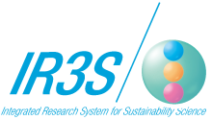
Rebuilding from the Great East Japan Earthquake:
The Role of Sustainability Science
ICSS 2012 : Sustainability Science in Action
February 21, 2012
Arizona State University, Tempe, Arizona
Kazuhiko Takeuchi
Deputy Executive Director and Professor, IR3S,
The University of Tokyo
Vice-Rector and Director, United Nations University Institute for Sustainability and Peace

Slide 2
Sustainability Science in Action
Sustainability science is an integrative discipline that produces comprehensive, high-level understanding of complex, long-term global issues.
Resolving these issues requires action: sustainability science and the establishment of sustainable societies are mutually dependent.
Sustainability science is an academic discipline whose growth will depend on new forms of scientific and social assessment that supplement peer review.
Action at IR3S focuses on the integration of low-carbon, resource-circulating, and nature-harmonious societies as a step toward creating sustainable societies.
IR3S also seeks to provide integrative methods of resolving the serious issues that confront Japan in the 21st Century, such as its decreasing and ageing population.
Designing a Sustainable Society
Sustainability Science
Sustainable Society
Integration
Symbiosis
Individual
Academic
Disciplines
Various
Industrial
Sectors
Dialogue
Evaluating Sustainability Science
The relationship between sustainability science
and sustainable societies
A Sustainable Society
Low-Carbon Society
Dramatic Reduction in CO2 Emissions
Resource-circulating Society
Integration of Production and Recycling
A Society in Harmony with Nature
Promotion of rich biota and healthy forestry and agriculture
Integrating
three societies
2

Slide 3
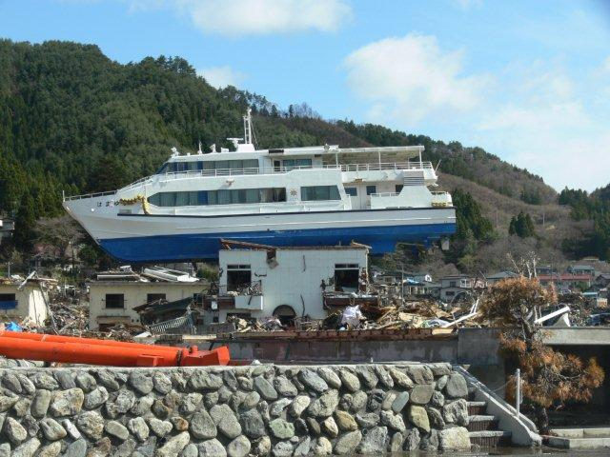
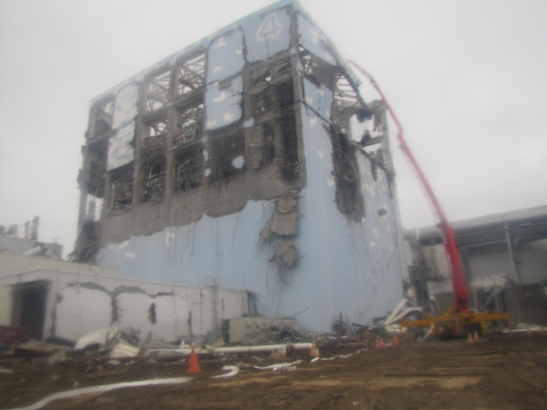
The Impact of the Great East Japan Earthquake on Sustainability Science
On March 11, 2011, Japan was devastated by an earthquake, tsunami, and nuclear accident. The impact of this triple disaster on the international community, as well as Japan, cannot be overstated.
Energy policy in particular will be significantly affected as a result of the unprecedented accident and hydrogen explosions at the Fukushima Daiichi Reactor caused by the earthquake and tsunami.
Involved in long-term efforts to resolve global issues, sustainability science has been faced with the more immediate, near-term issues of disaster recovery.
The key issue that emerges is how to create a "resilient society" that can respond both to sudden disasters like tsunamis and flooding, and to gradual transformations such as climate and ecosystem change
Sustainability science is called upon to provide disaster-recovery strategies that will build a sustainable society and address Japan's decreasing and ageing population.
Otsuchi-cho, Iwate Prefecture
http://www.tepco.co.jp/en/news/110311/indexold-e.html
Water pumping using
a concrete pumping car
(March 22nd, 2011) Fukushima Prefecture

Slide 4
Japanese Energy Policy in the 21st Century:
Major Changes as a Result of the Disaster
The use of nuclear power, which was expected to further grow in scale to help reduce CO2 emissions, will be reconsidered as a result of the accident.
As nuclear power plants were shut down, calls for large-scale conservation of electricity at peak hours of consumption proved very effective.
Efforts to accelerate increased production of renewable energy will grow; and economic incentives, such as feed-in tariffs, will be created.
Regulatory changes will allow consideration of new possibilities, such as mega-solar installations on abandoned farmland or geo-thermal power generated inside national parks.
A nuclear regulatory agency was established in February, 2012 under the Ministry of the Environment. Under the government’s environmental policy, the treatment of radioactive waste and clean-up of radioactive material have already begun.
4

Slide 5
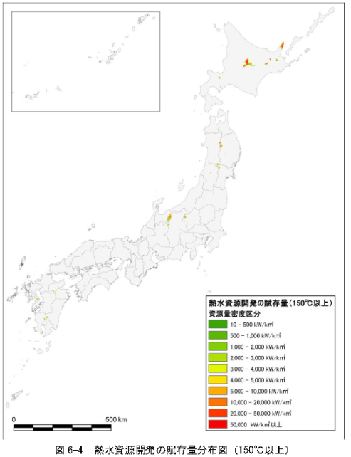
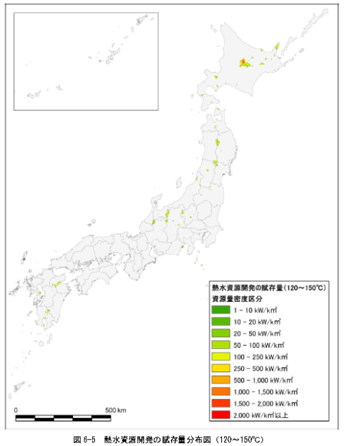
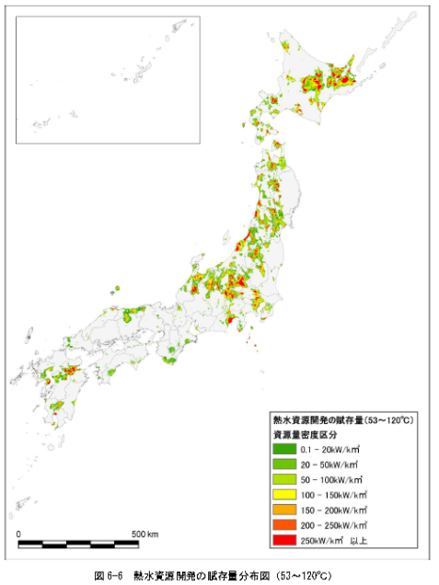
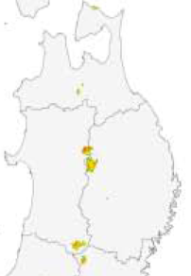
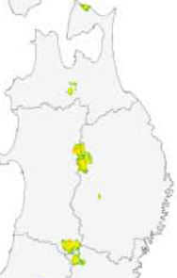
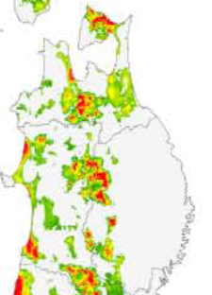
(10 MW)
(Year)
Comparison of electricity consumption at peak hours
Hydrothermal resources over 150°C are concentrated along the prefectural boundaries of Hokkaido, Iwate and Akita; and Nagano and Toyama.
Capacity: 23,600 MW
(Tohoku) Abundance in Iwate and Akita
Hydrothermal resources 120-150°C have a slightly wider distribution compared to the chart on the left.
Capacity: 1,080 MW
(Tohoku) Abundance in Iwate and Akita
Hydrothermal resources 53-120°C are distributed over a wide range mostly in East and North Japan.
Capacity: 8,490 MW
(Tohoku) Abundance in Aomori, Miyagi, Akita, Yamagata, Fukushima
Total 33,100MW
>150 degrees
120-150 degrees
53-120 degrees
Thermal energy's latent potential
From the Ministry of the Environment, Japan

Slide 6
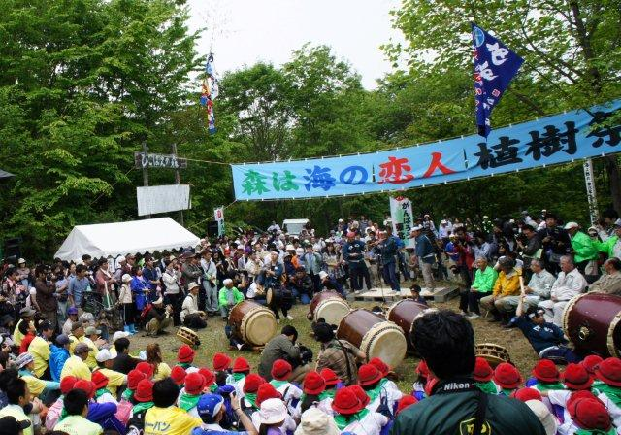

Aiding Disaster Recovery and the Concepts of Satoyama and Satoumi
The Satoyama Initiative adopted by the UN Convention on Biological Diversity/COP10 reflects shared awareness of the importance of socio-ecological production landscapes.
The ria-type coast of the disaster-affected Tohoku coastline is a classic example of an integrated Satoyama and Satoumi area. It shows the important linkages that exist between Satoyama and Satoumi.
Prof. Shigeatsu Hatakeyama, who argues that “the forest is logging for the sea, the sea is logging for the forest," has undertaken reforestation activities in upper river areas because they are the ocean's source of iron and other nutrients.
Regional revitalization as part of the disaster recovery effort must be undertaken with renewed attention to the linkages between Satoyama and Satoumi.
The Ministry of the Environment of Japan is focusing attention on Satoyama–Satoumi linkages. To aid disaster recovery, the Ministry is currently planning a new type of national park (tentatively named the “Sanriku Fukko National Park”).
Tree-planting festival, Kesennuma
Managing forests rich in biodiversity
Plankton
Seaweed
Oceans rich in marine biodiversity
6
The linkage between Satoyama and Satoumi
By: Ministry of the Environment of Japan

Slide 7
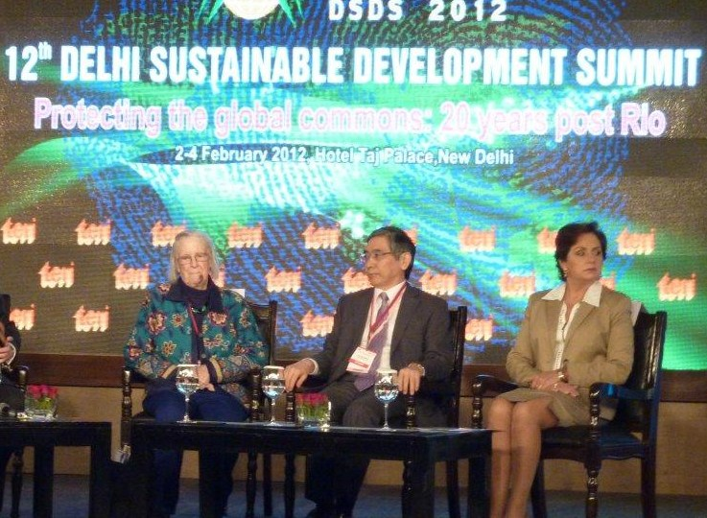
The New Commons and a New Business Model
Agriculture, forestry, and fishery are the primary industries in many of the areas affected by the disaster. Due to industry liberalization and the decreasing and ageing population of workers, these industries are in decline.
While disaster-recovery efforts must include rebuilding the agricultural, forestry, and fishing industries, the decline of these industries will only accelerate if they are merely restored.
A new form of joint resource management (a “new commons”) is needed. In addition to existing agricultural, forestry, and fishing workers, it should involve local municipalities, corporations, NPOs, and urban residents.
The creation of a nested framework of governance is especially needed to connect global and local commons.
The "sixth sector" can be grown by producing and processing distinctive regional, high value-added agricultural, forestry, and fishing products that can be marketed both domestically and internationally.
Prof. Elinor Ostrom (left)
Support the re-startup costs of fishing and aquaculture industries, and promote a transition to high production, high profit production systems
Relocate to higher ground
Make fishing ports/villages more eco-friendly
Solar panel
Create a Network of fishing ports
Evacuation Centre
Strengthen fishing ports
Consolidation and enhancement of Markets and Processing plants
7
Revitalizing the fishing ports

Slide 8
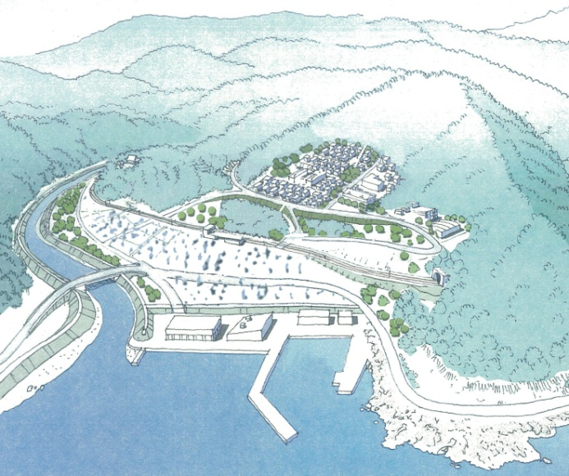
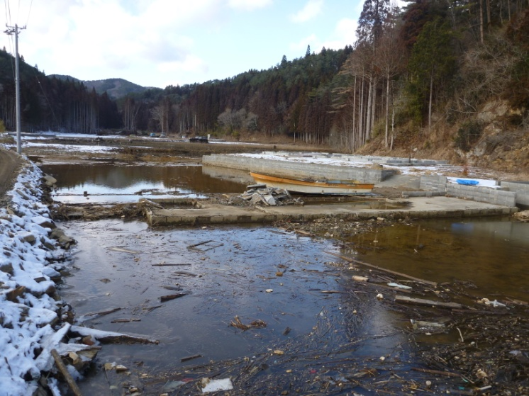
Building Compact and Resilient Societies
Urban relocation planning
Group relocation
There are important social issues to consider in areas affected by the disaster, where the population is decreasing and ageing, including the location of public facilities and compactness of urban areas.
Disaster-recovery efforts have recognized the need to relocate urban neighborhoods from areas where tsunami damage was severe or where the earth has sunk noticeably.
There are calls to relocate residential neighborhoods to higher ground. Because of limited available land, such development will necessarily need to be more compact.
Utilizing vulnerable land for farming and restoring natural marshlands will strengthen regional resilience.
As well as physical resilience, it is also important to strengthen societal resilience, for instance, by establishing emergency evacuation routes and conducting disaster-prevention training.
Residential area
Relocation area
→ Formulate planning regulations and restrict rebuilding of residences
By Ministry of Land,
Infrastructure,
Transport and
Tourism of Japan
Investigating the potential for reclamation of wetlands for subsided land at Karakuwa,
Kesennuma City
By Ministry of the Environment

Slide 9
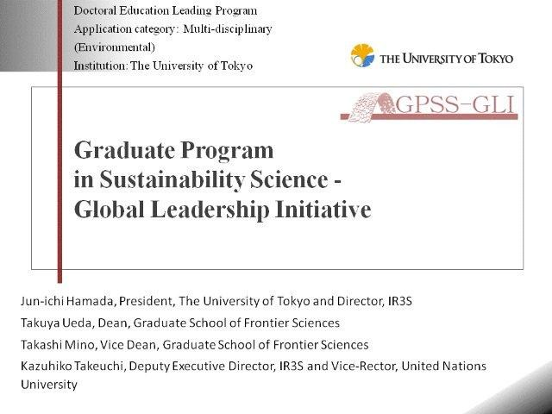
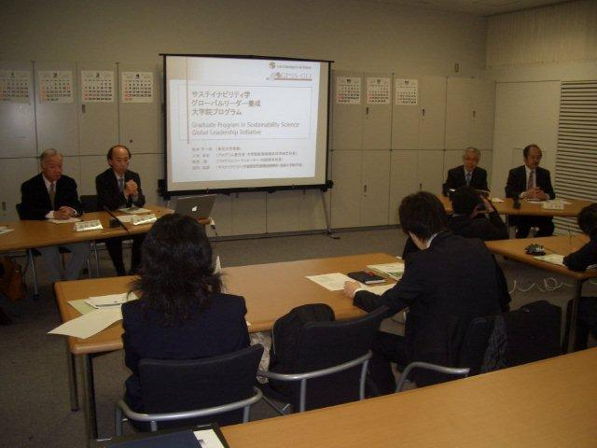
Leadership and "Sustainability in Action"
A lack of leadership and poor leadership on the part of the Japanese government, TEPCO, and others worsened the problems created by the Great East Japan Earthquake.
“Sustainability in action” requires coordinator's leadership to unite the many stakeholders.
To promote a nested framework of governance, leaders must be able to connect global and local perspectives.
An effective, comprehensive approach to problem-solving requires coordinated use of multiple skills so that a single action can resolve multiple problems.
The University of Tokyo launches its Program in Sustainability Science - Global Leadership Initiative in cooperation with UNU and ASU.
GPSS-GLI
9
GPSS-GLI Press conference

Slide 10
Thank You!

